Slide 1
Operating Systems Disk Scheduling Dr. Shamim Akhter

Slide 2
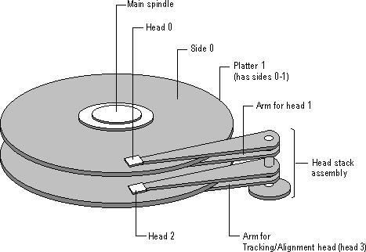
Illustration of a hard disk

Slide 3
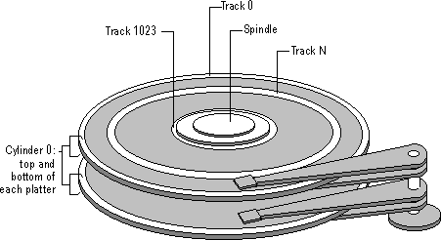
Tracks and Cylinders
same head position

Slide 4
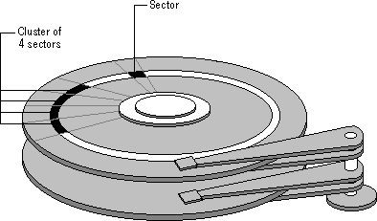
Sectors and Clusters
Rotational
Latency/delay
Seek Time
Seek Time: Position R/W head over desire track
Rotational Delay: Wait time for the desire sector to rotate under R/W head

Slide 5
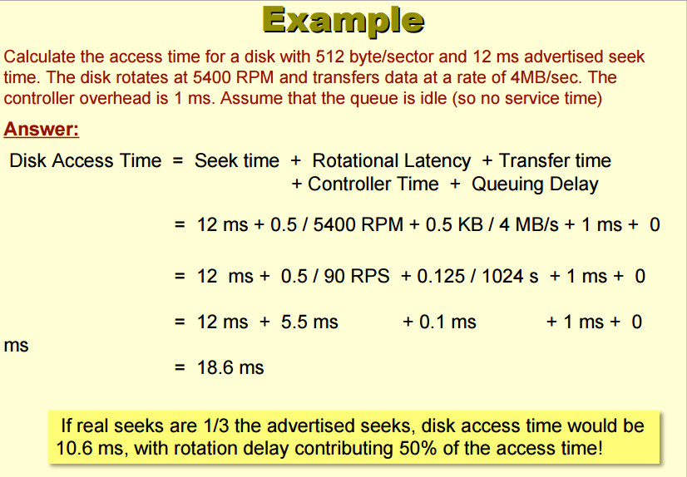

Slide 6
Disk Scheduling
The operating system is responsible:
having a fast access time and disk bandwidth.
Access time has two major components
Seek time is the time for the disk are to move the heads to the cylinder containing the desired sector.
Rotational latency is the additional time waiting for the disk to rotate the desired sector to the disk head.
Minimize seek time
Seek time ≈ seek distance
Disk bandwidth is the total number of bytes transferred, divided by the total time between the first request for service and the completion of the last transfer (turnaround).

Slide 7
Disk Scheduling (Cont.)
Several algorithms exist to schedule the servicing of disk I/O requests.
We illustrate them with a request queue (0-199).
98, 183, 37, 122, 14, 124, 65, 67
Head pointer 53

Slide 8
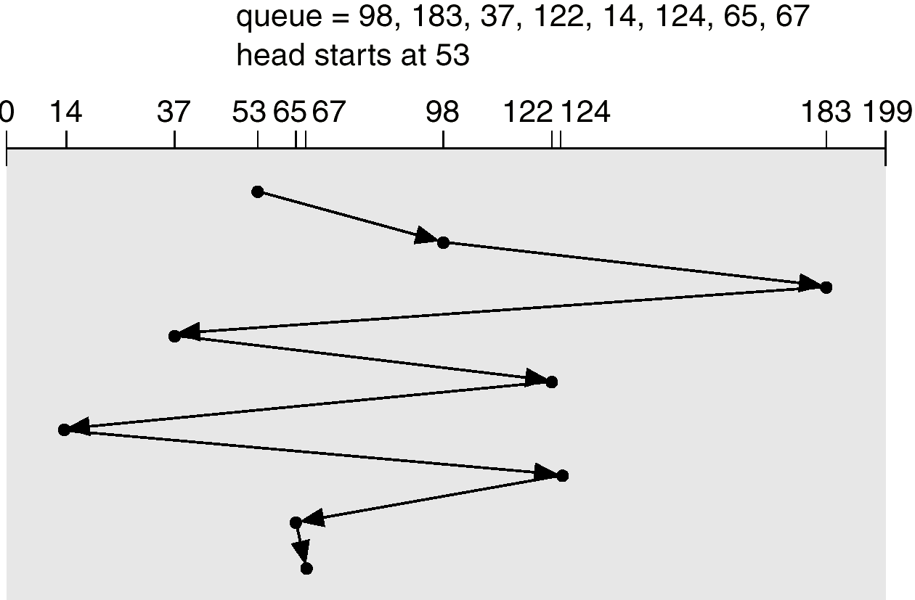
FCFS
Illustration shows total head movement of 640 cylinders.

Slide 9
SSTF
Selects the request with the minimum seek time from the current head position.
SSTF scheduling is a form of SJF scheduling; may cause starvation of some requests.
Illustration shows total head movement of 236 cylinders.

Slide 10
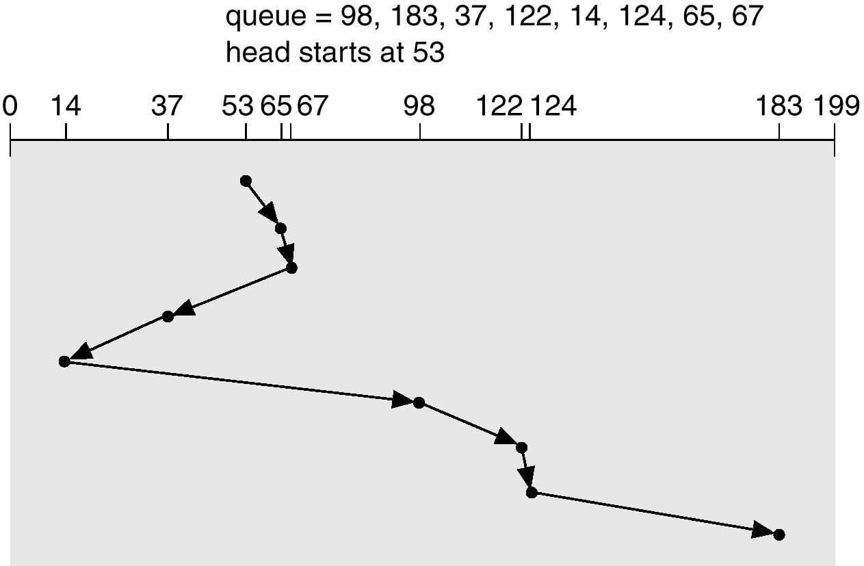
SSTF (Cont.)

Slide 11
SCAN
The disk arm starts at one end of the disk, and moves toward the other end, servicing requests until it gets to the other end of the disk, where the head movement is reversed and servicing continues.
Sometimes called the elevator algorithm.
Illustration shows total head movement of 208 cylinders.

Slide 12
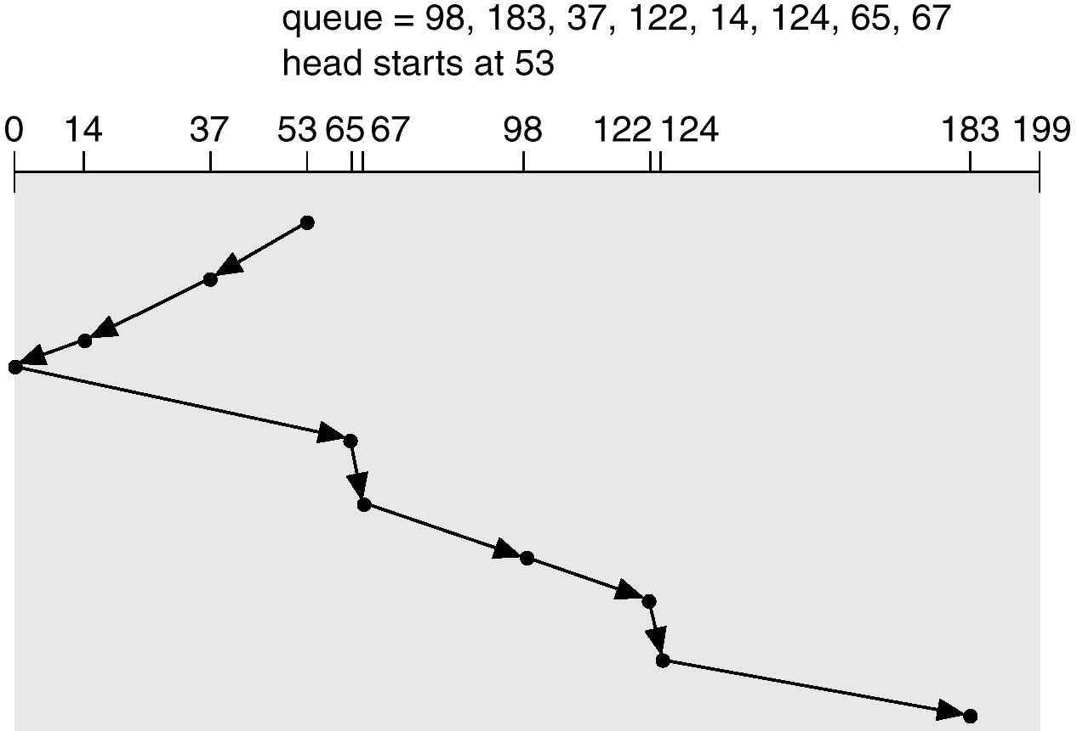
SCAN (Cont.)

Slide 13
C-SCAN
Provides a more uniform wait time than SCAN.
The head moves from one end of the disk to the other. servicing requests as it goes. When it reaches the other end, however, it immediately returns to the beginning of the disk, without servicing any requests on the return trip.
Treats the cylinders as a circular list that wraps around from the last cylinder to the first one.

Slide 14
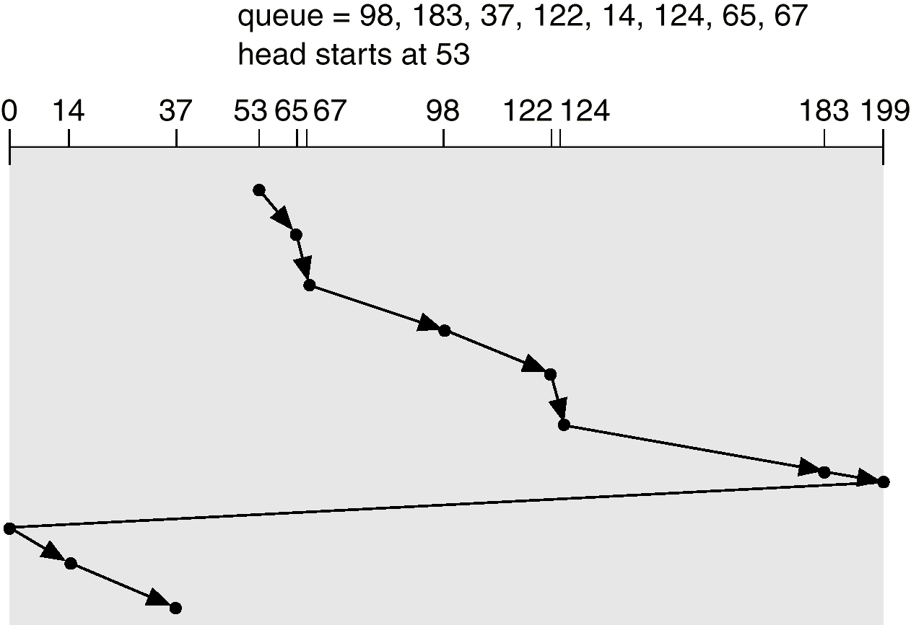
C-SCAN (Cont.)

Slide 15
C-LOOK
Version of C-SCAN
Arm only goes as far as the last request in each direction, then reverses direction immediately, without first going all the way to the end of the disk.

Slide 16
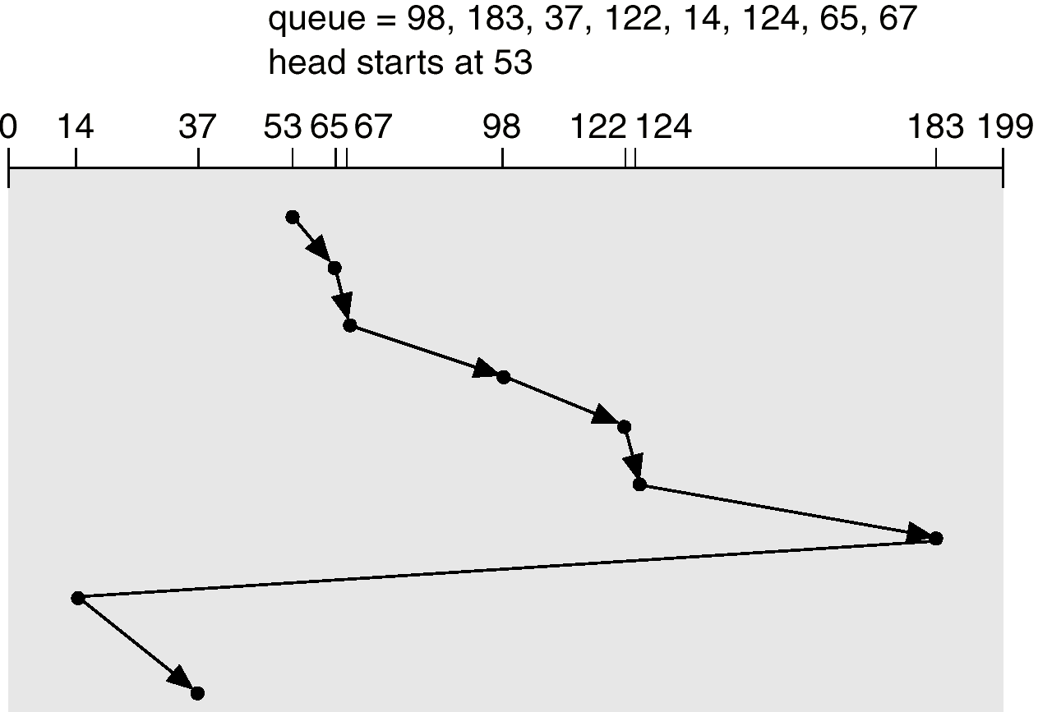
C-LOOK (Cont.)

Slide 17
Selecting a Disk-Scheduling Algorithm
SSTF is common and has a natural appeal
SCAN and C-SCAN perform better for systems that place a heavy load on the disk.
Performance depends on the number and types of requests.
Requests for disk service can be influenced by the file-allocation method.
The disk-scheduling algorithm should be written as a separate module of the operating system, allowing it to be replaced with a different algorithm if necessary.
Either SSTF or LOOK is a reasonable choice for the default algorithm.

Slide 18
Disk Scheduling Policies
Seek time is the reason for differences in performance
For a single disk there will be a number of I/O requests
If requests are selected randomly, get poor performance

Slide 19
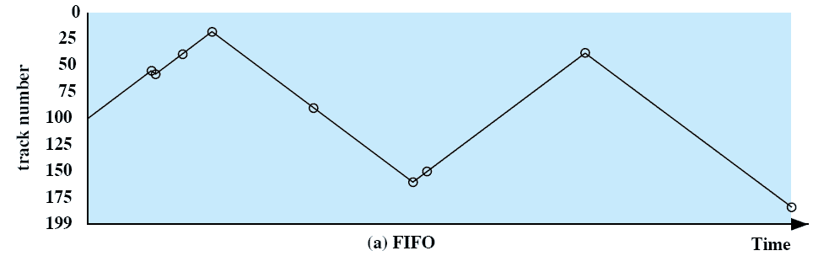
Disk Scheduling Policies
First-in, first-out (FIFO)
Process request sequentially
Fair to all processes
Approaches random scheduling in performance if there are many processes
Example: 55, 58, 39, 18, 90, 160, 150, 38, 184

Slide 20
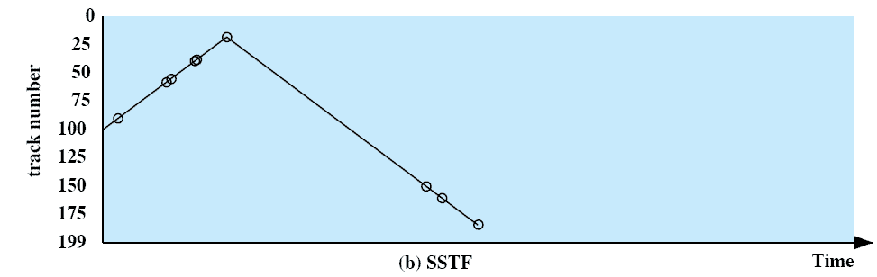
Disk Scheduling Policies
Shortest Service/Seek Time First
Select the disk I/O request that requires the least movement of the disk arm from its current position
Always choose the minimum seek time
Example: 55, 58, 39, 18, 90, 160, 150, 38, 184
Requests for tracks far away from the current position may never be served, if requests for closer tracks are issued continuously

Slide 21
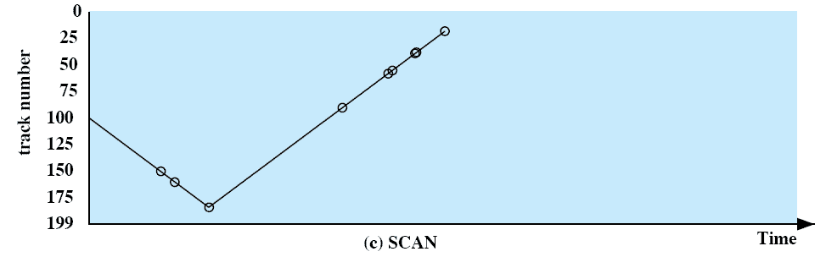
Disk Scheduling Policies
SCAN (Elevator Algorithm)
Arm moves in one direction only, satisfying all outstanding requests until it reaches the last track in that direction
Direction is reversed
Example: 55, 58, 39, 18, 90, 160, 150, 38, 184

Slide 22

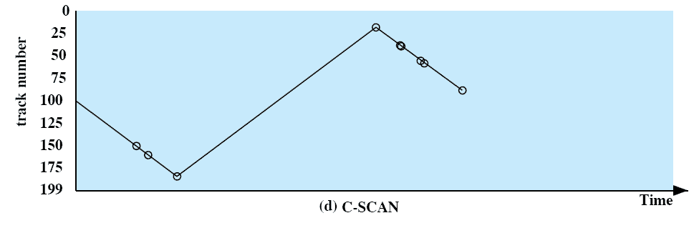
Disk Scheduling Policies
C-SCAN
Restricts scanning to one direction only
When the last track has been visited in one direction, the arm is returned to the opposite end of the disk and the scan begins again
In case of repetitive requests to one track, we will see “arm stickiness” in SSTF, SCAN, C-SCAN

Slide 23
Disk Scheduling Policies
N-step-SCAN
Segment the disk request queue into subqueues of length N
Subqueues are processed one at a time, using SCAN
New requests added to other queue when a queue is processed

Slide 24
Disk Scheduling Policies
FSCAN
Two subqueues
One queue is empty for new requests

Slide 25
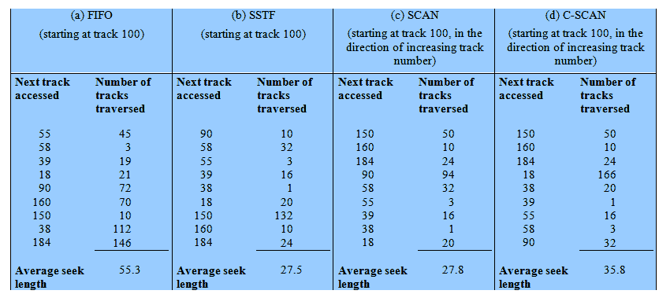
Disk Scheduling Algorithms

